Slide 1
Simulating Nucleation in the Ising Model
Charlie Cook

Slide 2
Introduction and motivation
Nucleation governs (most) 1st order phase transitions
Phase transition e.g. water from ice
Supercooled water
Simulate using a simple ‘Ising model’ & metropolis algorithm
Nucleation of supercooled water ^{[1]}
[1] Physics Exchange Stack (2014)
Notes:
Let’s start with why we even care about nucleation to begin with. As I’m sure you are aware, many different materials undergo things called phase transitions, whereby they go from one state to another. Perhaps the most common example being water converting into ice. Growing up, you would have been told in school that water freezes into ice at 0 degrees celcisus, however its not quite that simple, and you can infact cool water below zero degrres and have it still remain a liquid, known as supercooled water. The reason behind why this can occur is related to nucleation

Slide 3

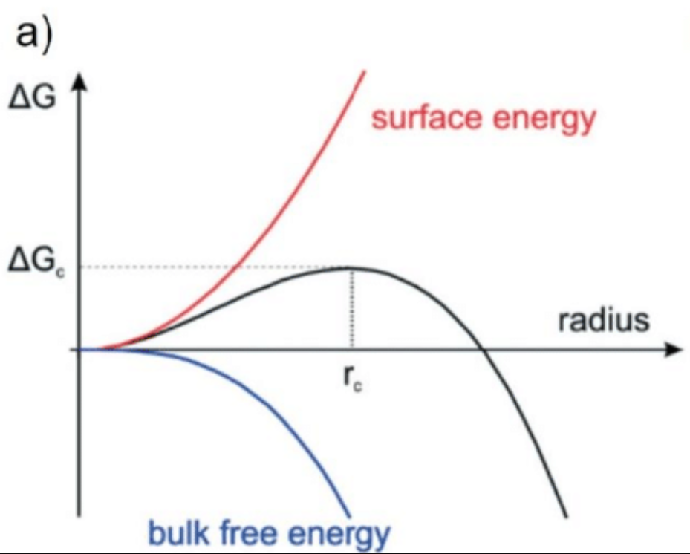

What is nucleation?
Metastable phase
Stochastic (random) process
Small clusters form, growing or shrinking
$ΔF\left(R\right)=2πRσ−πR^{2}Δf^{\left[2\right]}$ - Energy barrier
Critical radius – gain > cost
Stable phase
Cost
Gain
[2] Santra, M et al.(2008)
[3] Flatken, M. A. (2022
Figure from ^{[3]}

Slide 4
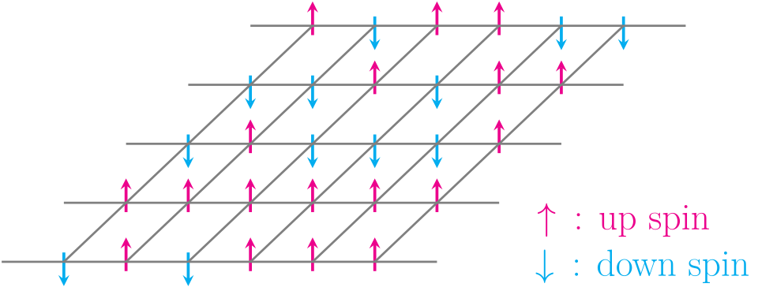
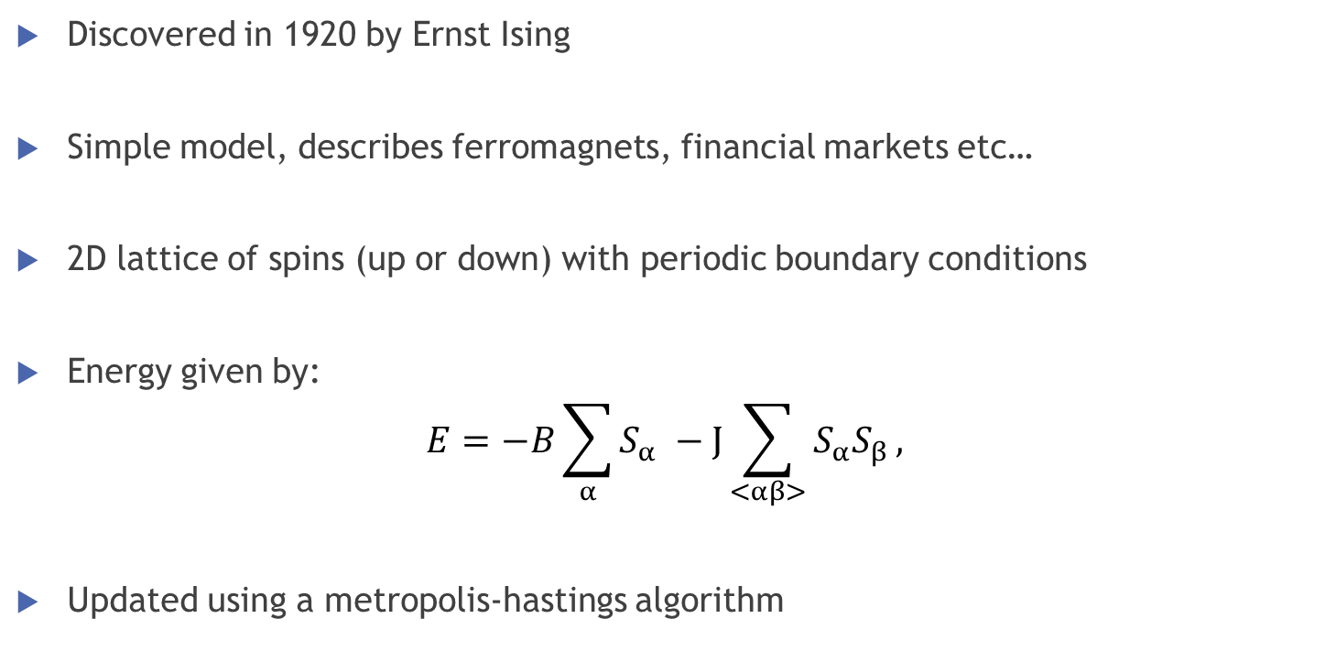
Ising Model
2D Ising model^{[4]}
Discovered in 1920 by Ernst Ising
Simple model, describes ferromagnets, financial markets etc…
2D lattice of spins (up or down) with periodic boundary conditions
Energy given by:
$$E=−B\sum_{α}{S_{α}} −J\sum_{<αβ>}{S_{α}S_{β}},$$
Updated using a metropolis-hastings algorithm
Field contribution
Spin contribution
[4] Wikipeida (2026)

Slide 5
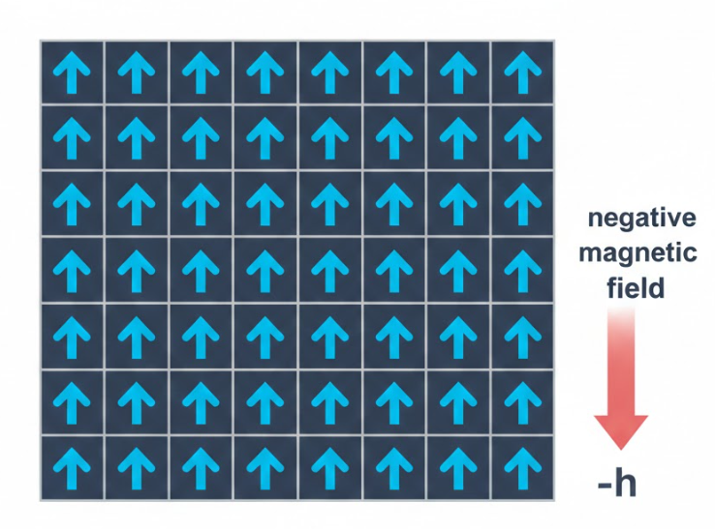
How do we use this to model nucleation rates?
Generate a up/down spin lattice
Place it in an external field (opposite to the spins) – metastable
Run metropolis algorithm – random fluctuations
measure number of runs until magnetisation meets threshold
Repeat & calculate average run time (in Monte Carlo Cycles/sweeps)

Slide 6
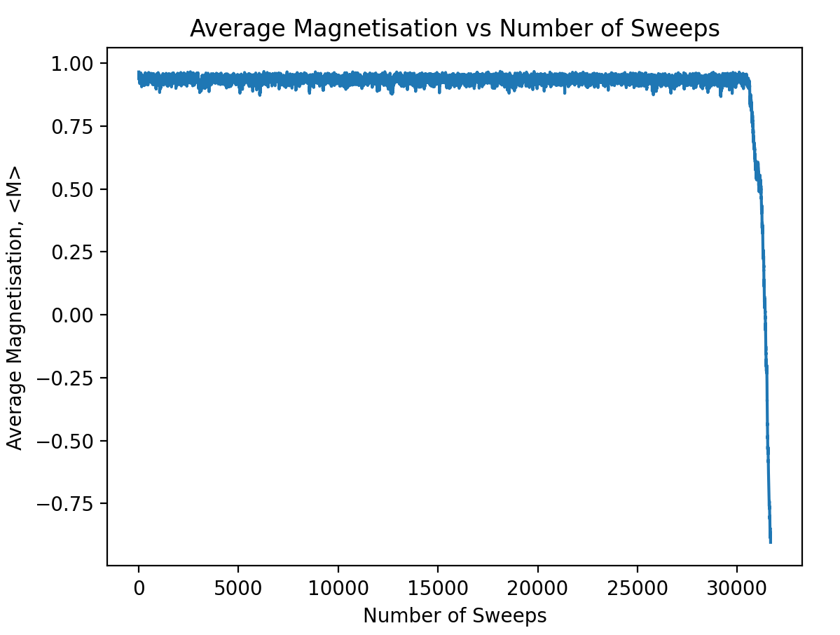
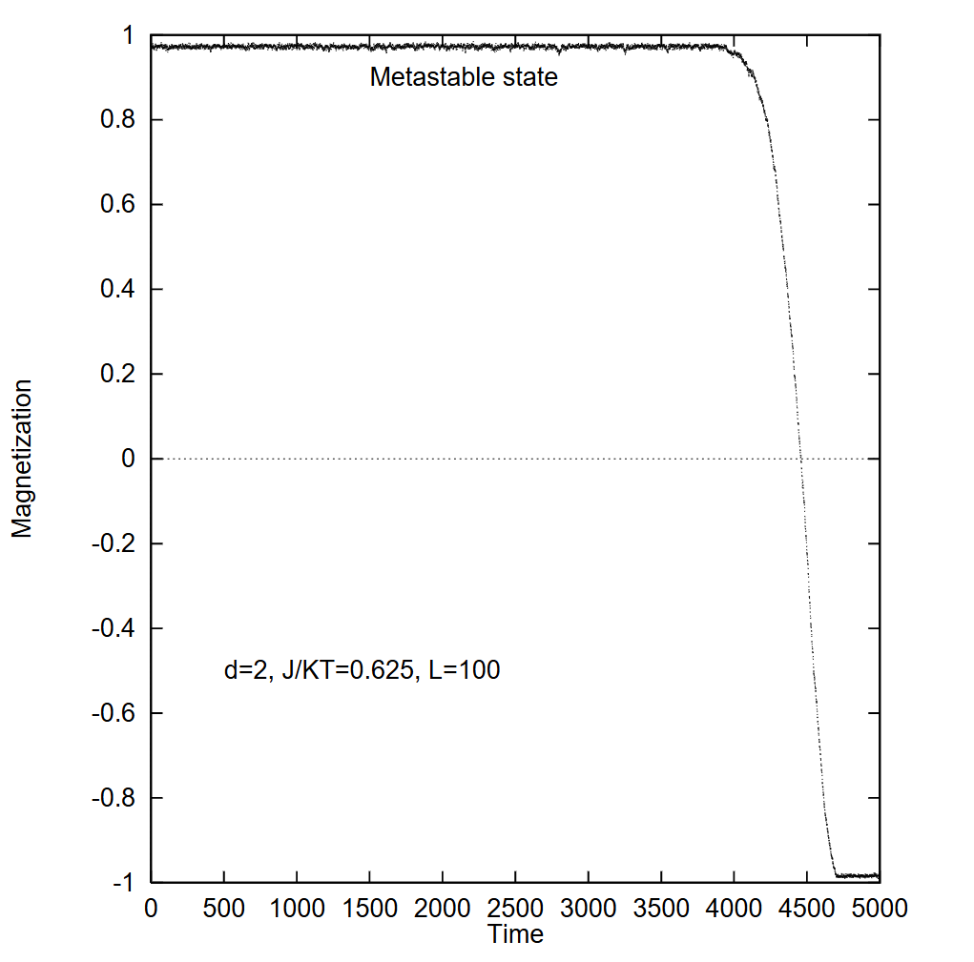
What should we expect to see?
Fig: Nucleation/decay of metastable state taken from ^{[5]}
Fig: Example of nucleation/decay of metastable stable from my code
[5] Acharyya, M (1998)

Slide 7
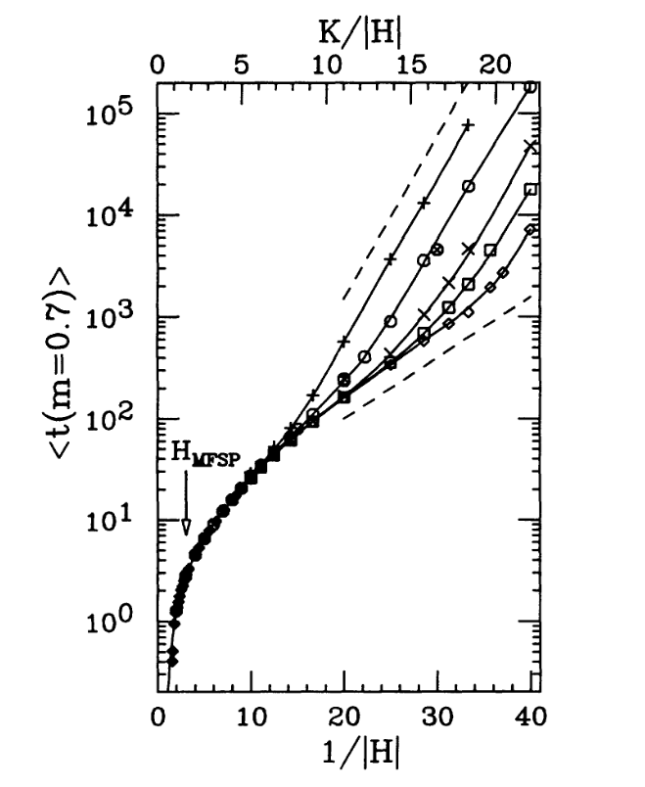
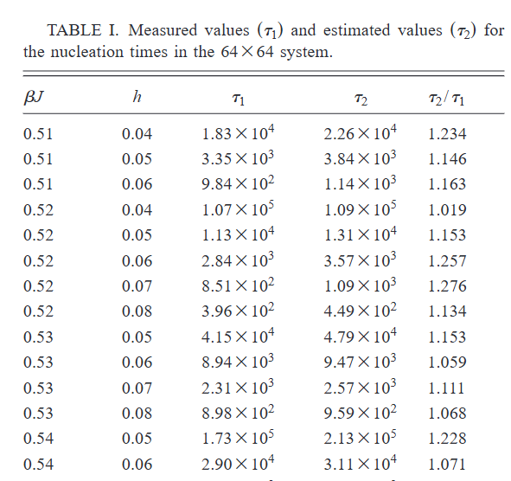
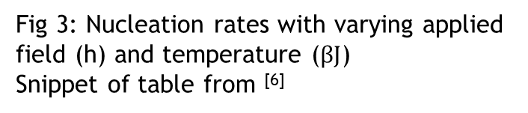
What should we expect to see?
Fig 3: Nucleation rates with varying applied field (h) and temperature ($βJ$)
Snippet of table from ^{[6]}
T↓
B↑
Fig 2: Nucleation rates with varying applied field (H) and system size, taken from ^{[7]}
[6] Brendel, K (2005)
[7] Rikvold, P.A (1994)

Slide 8
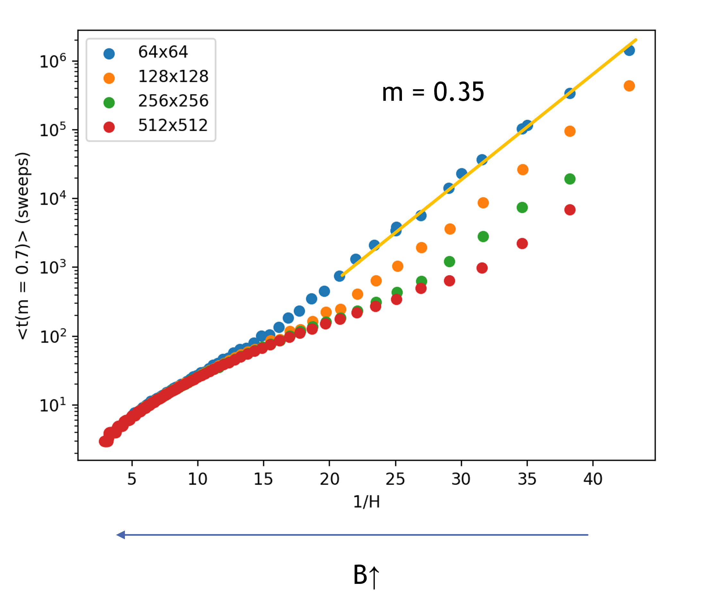
My current data
m = 0.36

Slide 9
Conclusions
Nucleation can be modelled using the Ising model
Replicated key literature results
Potential Extensions
Explore the lattice size dependence
Compare boundary condition effects (i.e helical vs periodic)
Calculate free energy, compare to Becker-Doring theory

Slide 10
References
Santra, M., Chakrabarty, S., & Bagchi, B. (2008). Gas–Liquid Nucleation in Two Dimensional System. arXiv:0809.2466 [cond-mat.stat-mech]
Flatken, M. A. (2022). Models of CNT: Dependence of cluster free energy, ∆G, on the cluster radius according to classical nucleation theory (CNT) [Figure 3]. In The early stages of halide perovskites thin film formation (Thesis). Reprinted with permission from Polte (CrystEngComm, 17, 6809, 2015). Retrieved from https://www.researchgate.net/publication/361610666/figure/fig3/AS:1172304964911104@1656510692179/Models-of-CNT-a-Dependence-of-cluster-free-energy-G-on-the-cluster-radius-according.png
"Physics Stack Exchange. (2014). Why do ice crystals form from the top to the bottom of a bottle filled with supercooled water? [Online GIF]. Available at: https://physics.stackexchange.com/questions/457410 (Accessed: February 2026).
Wikipedia contributors. (2026). Ising model. Wikipedia, The Free Encyclopedia. Available at: https://en.wikipedia.org/wiki/Ising_model (Accessed: February 2026).
Acharyya, M., & Stauffer, D. (1998). Nucleation and hysteresis in Ising model: Classical theory versus computer simulation (arXiv:cond-mat/9801213). arXiv. https://arxiv.org/abs/cond-mat/9801213
Brendel, K., Barkema, G. T., & van Beijeren, H. (2005). Nucleation times in the two-dimensional Ising model. Physical Review E, 71(3), 031601. https://doi.org/10.1103/PhysRevE.71.031601
Rikvold, P. A., Tomita, H., Miyashita, S., & Sides, S. W. (1994). Metastable lifetimes in a kinetic Ising model: Dependence on field and system size. Physical Review E, 49(6), 5080–5090. https://doi.org/10.1103/PhysRevE.49.5080
AI was not used to create this presentation

Slide 11
Any questions?

